Slide 1
LSTM for predicting Bitcoin market price
徐浩翔-Lance-ST7014

Slide 2
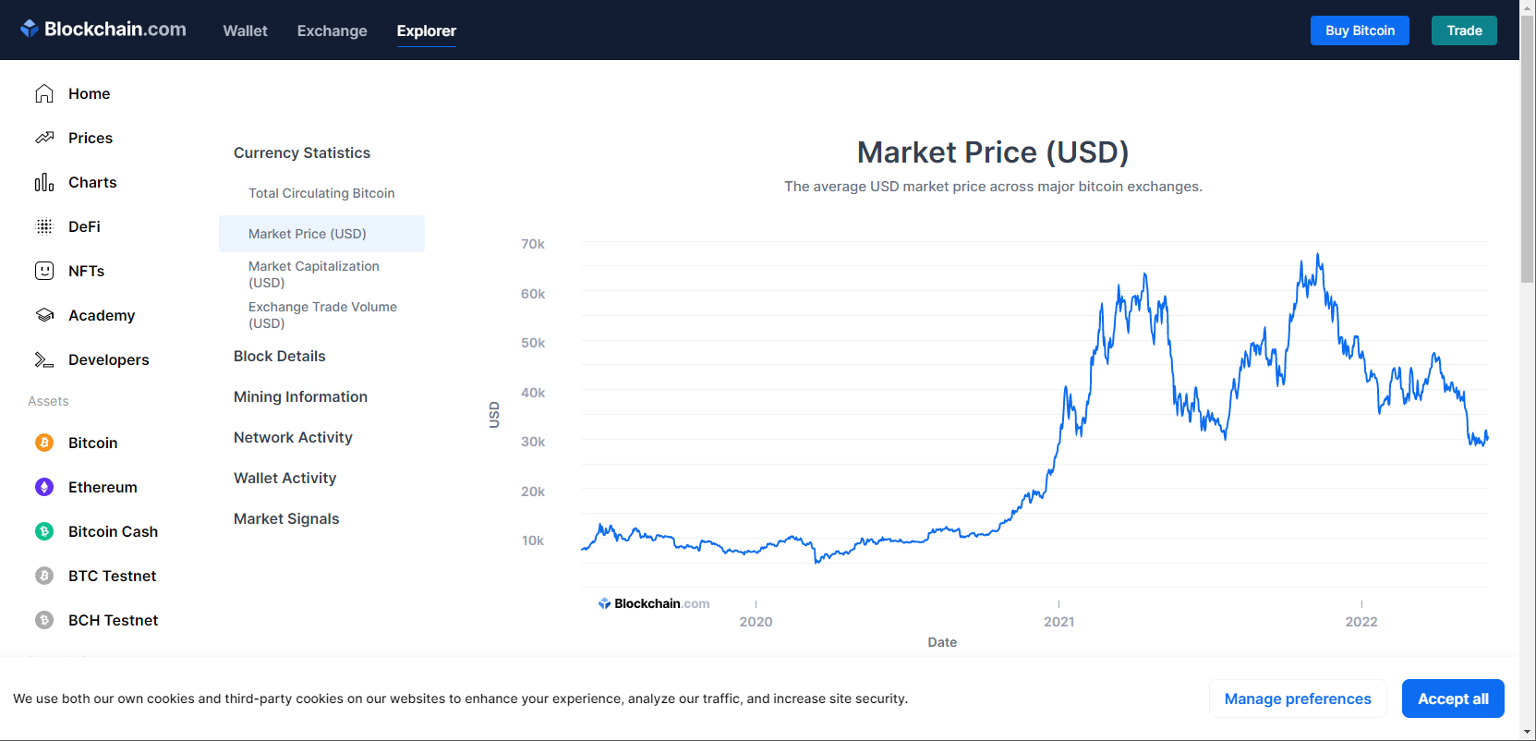
Data Source
https://www.blockchain.com/charts/market-price

Slide 3
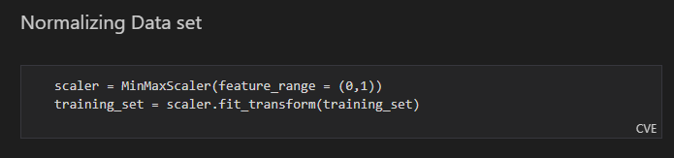
Normalizing Data
Normalization Formula:
Xnorm = (X – min(X)) / (max(X) – min(X))

Slide 4
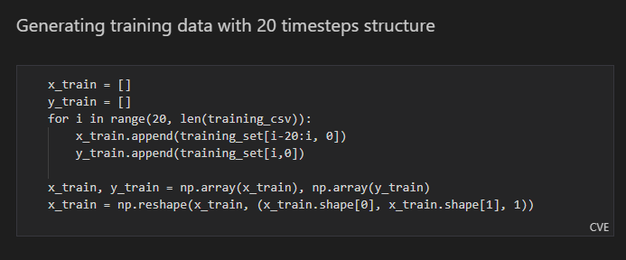
Formatting training data
20 timesteps structure
Assume X is a set from i-20th to i-1th Element
Y is the ith Element that we are predicting

Slide 5
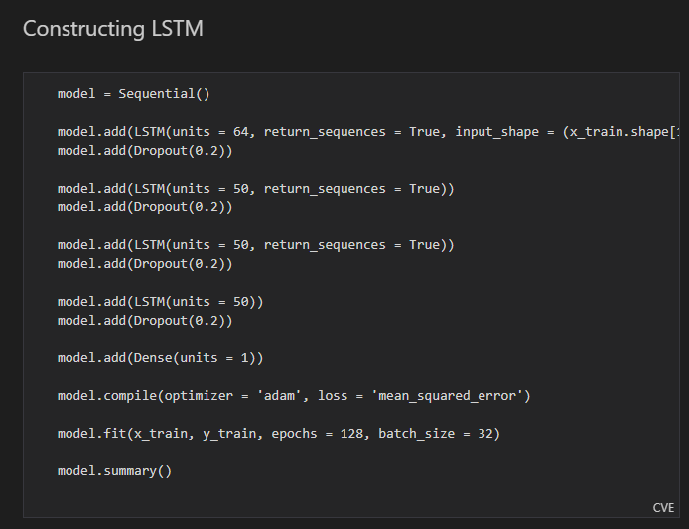
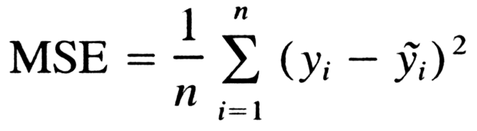
The LSTM
Each LSTM layer has 64 unit of neurons
With 20% dropout rate to Dropout 20% of neurons during each iteration of training to avoid overfitting
Mean Squared Error Loss Function

Slide 6
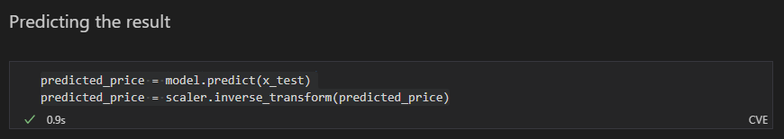
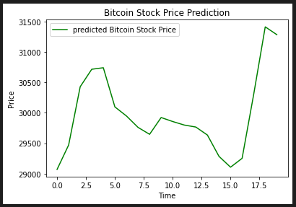
Predicting
Inverse scaling the output prediction
Trend of Bitcoin market price for the next 20 days

Slide 7
Credits
https://www.blockchain.com/charts/market-price
https://www.freecodecamp.org/news/machine-learning-mean-squared-error-regression-line-c7dde9a26b93/
https://www.superdatascience.com/blogs/the-ultimate-guide-to-recurrent-neural-networks-rnn

